Slide 1
Electromagnetic Radiation

Slide 2
Objectives
1. Name the different types of electromagnetic radiation and describe each.
2. Describe the characteristics of electromagnetic waves.
3. Describe the relationships between frequency, wavelength, velocity, and energy of electromagnetic radiation.
4. Define radiation intensity and describe how it varies with distance from the radiation source.

Slide 3
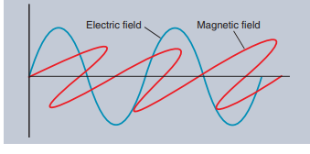
Electromagnetic Radiation
All electromagnetic radiation consists of simultaneous electric and magnetic waves.
Typically, only one of these waves is used in illustrations.
Only the electric wave is shown in illustrations.
These waves are really fluctuations caused by vibrating electrons within the fields.

Slide 4
Electromagnetic Radiation
The amount of vibrations of the electrons will determine the frequency and wavelength for the various types of electromagnetic radiations.
Electromagnetic radiation travels at the speed of light, and
each type has its own unique frequency and wavelength

Slide 5
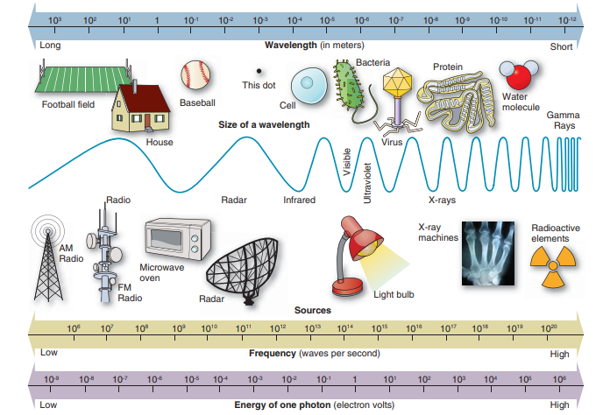
Electromagnetic radiation may appear in the form of visible light, x-rays, infrared, or radio waves, depending on its energy.
The entire band of electromagnetic energies is known as the electromagnetic spectrum.

Slide 6
The electromagnetic spectrum lists the different types of electromagnetic radiations varying in energy, frequency, and wavelengths.
The energy of the radiation is measured in electron volts or eV.

Slide 7
Figure illustrates the different forms of the electromagnetic spectrum from long-wavelength, low-energy radio waves, to short-wavelength, high-energy gamma rays.
Although Figure appears to indicate sharp transitions between the types of radiations, there are no clear boundaries between the various regions in the electromagnetic spectrum

Slide 8
Radio Waves
Radio waves are long-wavelength (1–10,000 m), low-energy radiation waves.
Radio frequency radiation is used in MRI.
Cell phones utilize radio waves to transmit information from one cell tower to another and finally to a cell phone.
Television antennae receive the electromagnetic wave from the broadcast station and
the image is displayed on the television screen.

Slide 9
Radar and Microwaves
Radar and microwaves have shorter wavelengths (10⁻¹– 10⁻⁴m) and higher energy than radio waves.
Microwaves are used in ovens, in transportation, and by law enforcement officers to monitor the speed of cars.
In a microwave oven, the microwave energy forces the water molecules in food to rapidly vibrate, thus heating the food

Slide 10
Infrared Radiation
Infrared radiation, or heat, has shorter wavelengths and higher energy than radar and microwaves (10⁻¹–10⁻⁴ m).
Infrared radiation can heat nearby objects.
For example, you can feel the heat from your toaster, which uses infrared radiation.
The high-energy end of the infrared region is visible and can be seen in the red heating elements of your toaster.

Slide 11
Visible Light
Visible light selectively activates cells in the eye.
It occupies a narrow band in the electromagnetic spectrum, with wavelengths between 10⁻⁶ and 10⁻⁷ m.
The color red has the longest wavelength and lowest energy.
Blue and violet colors have the highest energy and the shortest wavelengths in the visible spectrum.

Slide 12
Ultraviolet
Ultraviolet is the part of the spectrum just beyond the higher energy end of the visible light region.
Ultraviolet wavelengths range from 10⁻⁷ to 10⁻⁹ m.
Ultraviolet lights are used in biological laboratories to destroy airborne bacteria, and they are believed to be responsible for the majority of sunburn and skin cancer

Slide 13
X-Rays and Gamma Rays
X-rays and gamma rays have wavelengths between 10⁻⁹ and 10⁻¹⁶ m.
They are very short wavelength, highfrequency, high-energy radiation.
The energy is measured in thousands of electron volts (keV) and is capable of ionization.
Ionizing radiation such as x-rays and gamma rays has enough energy to remove an electron from its orbital shell.

Slide 14
X-Rays and Gamma Rays
The only difference between x-rays and gamma rays is their origin.
X-rays in radiology come from interactions with electron orbits.
Gamma rays come from nuclear transformations (decay) and are released from the nucleus of a radioactive atom.
Some x-rays in radiology have higher energy than some gamma rays and are used in radiation therapy to treat cancer.
X-radiation is utilized in various industries including for screening baggage in airport security and large crates of merchandise at ports of entry as well as for imaging chest plates the military will use in combat

Slide 15
Characteristics of Electromagnetic Radiation
Electromagnetic radiation consists of vibrations in electric and magnetic fields.
It has no charge and no mass and travels at the speed of light.
The waves move in a sinusoidal (sine) waveform in electric and magnetic fields.

Slide 16
Characteristics of Electromagnetic Radiation
Electromagnetic radiation is described in terms of the following characteristics:
Velocity: how fast the radiation moves
Frequency: how many cycles per second are in the wave
Period: the time for one complete cycle
Wavelength: the distance between corresponding parts of the wave
Amplitude: the magnitude of the wave
Energy: the amount of energy in the wave
Intensity: the flux of energy

Slide 17
Velocity
All electromagnetic radiation travels in a vacuum or in air at 3 × 10⁸ m/s , regardless of whether it is in a wave or particle form.
Even though this is incredibly fast, light requires some time to travel huge distances.
For example, it takes 8 minutes for light from the Sun to reach the Earth.

Slide 18
Frequency
The frequency of a wave is the number of cycles per second.
That is, the frequency is the number of peaks or valleys occurring each second.
The unit of frequency is hertz (Hz), which is one cycle per second.
In the United States, electricity has a frequency of 60 Hz, that is, 60 cycles per second.
A typical radio wave has 700,000 Hz (700 kHz).
A 1,000 Hz is equal to 1 kHz.
One megahertz (MHz) is equal to one million (10⁶ ) Hz or cycles per second.

Slide 19
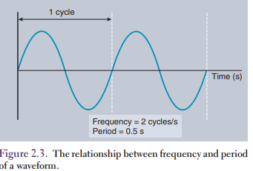
Period
The period of a wave is the time required for one complete cycle.
A wave with a frequency of two cycles per second has a period of one-half second; that is, one complete wave cycle occurs each half second.
Figure 2.3 illustrates the relationship between frequency and period (time) in a sine wave.

Slide 20
Wavelength
The distance between adjacent peaks or adjacent valleys of a wave is the wavelength and is represented by lambda (λ).
Wavelength is one of the important characteristics in determining the properties of x-rays.
Electromagnetic radiation with shorter wavelengths has higher energy and frequencies and greater penetration.
Wavelength is measured in meters, centimeters, or millimeters.

Slide 21
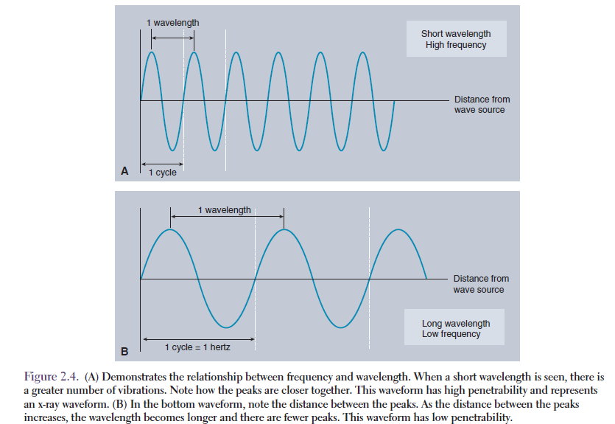
(A) Demonstrates the relationship between frequency and wavelength.
When a short wavelength is seen, there is a greater number of vibrations.
Note how the peaks are closer together.
This waveform has high penetrability and represents an x-ray waveform.
(B) In the bottom waveform, note the distance between the peaks.
As the distance between the peaks increases, the wavelength becomes longer and there are fewer peaks.
This waveform has low penetrability.

Slide 22
Wavelength
Figure 2.4 illustrates the relation between wavelength and frequency.
Electromagnetic wave velocity, frequency, and wavelength are related and a change in one factor causes a change in one or both of the other factors.

Slide 23
Wavelength
The wave is demonstrated with this formula:
c f = λ
where
c (velocity) is the speed of light (3 × 10⁸ m/s, in air),
f is the frequency, and
lambda (λ ) is the wavelength.

Slide 24
Wavelength
Note that the product of frequency and wavelength must always equal the velocity.
Thus, frequency and wavelength are inversely proportional.
Therefore, if the frequency increases, the wavelength must decrease, and if the frequency decreases, the wavelength must increase.
For example, if frequency is doubled, the wavelength is halved, and if the frequency is tripled, the wavelength is reduced by one third

Slide 25

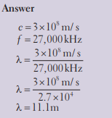

Slide 26

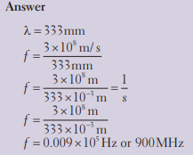

Slide 27
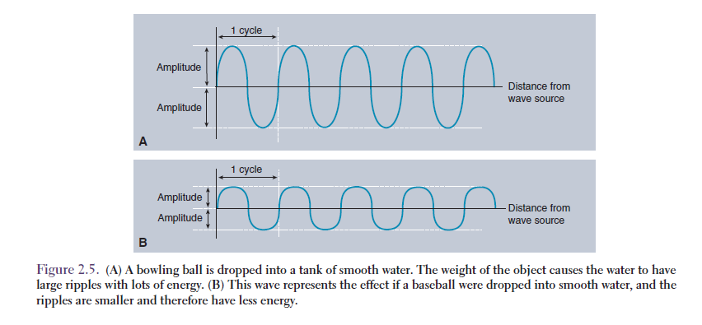
Amplitude
The amplitude of a wave is the maximum height of the peaks or valleys (in either direction) from zero.
As the energy of the wave increases, the height of the wave also increases.
Figure 2.5 compares the amplitudes of two electromagnetic waves as a function of time.

Slide 28
Energy: Electromagnetic Radiation as a Particle
Electromagnetic radiation usually acts as a wave, but sometimes it acts as a particle.
When electromagnetic radiation acts as a wave, it has a definite frequency, period, and wavelength.
When electromagnetic radiation acts as a particle, it is called a photon or quanta.
We use the photons or bundles of energy to produce x-radiation.

Slide 29
Energy: Electromagnetic Radiation as a Particle
The energy and frequency of the photons are directly proportional, but wavelength and energy are inversely proportional.
Thus, the higher the energy, the shorter the wavelength and the higher the frequency.
The formula that describes the relationship between photon energy and frequency is expressed as:
E =hf
where E is photon energy in electron volts,
h is a conversion factor called Planck’s constant (4.15 × 10⁻¹⁵ eVs), and
f is the photon frequency

Slide 30


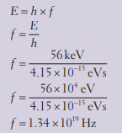


Slide 31
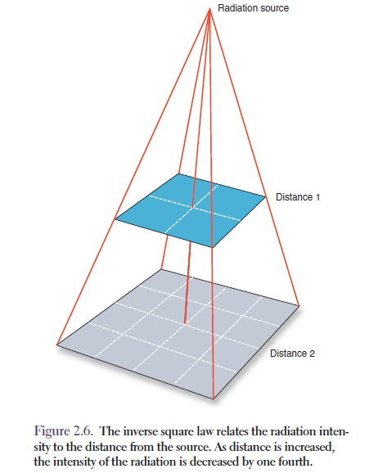
Radiation Intensity and the Inverse Square Law
All electromagnetic radiation travels at the speed of light and diverges from the source at which it is emitted.
Intensity is energy flow per second and is measured in watts/ cm² .
The intensity of the radiation decreases with an increase in the distance from the source.
This is because the x-ray energy is spread over a larger area.
This relation is known as the inverse square law.
It is called the inverse square law because the intensity is inversely proportional to the square of the distance.
Figure 2.6 illustrates how the intensity decreases as the distance from the source increases.

Slide 32

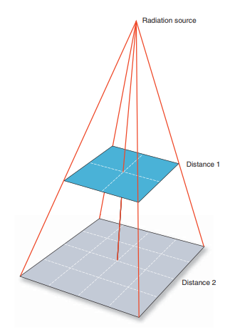
Mathematically, the inverse square law is expressed as follows:
where I1 , old intensity; I2 , new intensity; d1 2 , old distance squared; d2 2 , new distance squared.
If the distance from the x-ray source is doubled, the intensity decreases by a factor of 4.
That is, the intensity at twice the distance is one-fourth the original value.
If the distance from the x-ray source is halved, the intensity is four times greater.

Slide 33
The exposure and exposure rate from an x-ray source also follow the inverse square law.
To decrease radiation exposure during a fluoroscopic exam, a technologist needs to increase his or her distance from the x-ray tube.
Every step away from the tube decreases the amount of radiation the technologist will be exposed to

